Slide 1


Apple Stock Price Prediction
Md Saimoom Ferdous, PhD
Springboard Data Science Career Track, March 2020 Cohort
Mentored by
Rahul Sagrolikar
Senior Data Scientist, Amazon

Slide 2
Table of Contents
Problem Statement
Project Flow, Business & Model Understanding
Data Collection
Dividend, Earning and Stock price data
Exploratory Data Analysis
Correlated Financial Variables
Machine Learning Modelling
ARIMA
FBProphet
XGBoost
Conclusion

Slide 3

Section 1:
Problem Statement

Slide 4
Project Flow
Problem
Solution
Less accurate forecasting
Increase forecasting accuracy
Business
Unable to model economic uncertainty
Takes into account economic downturns
Time-series Forecasting

Slide 5
Project Flow - Details
Problem
Solution
Apples stock price forecast is of great interest for millions of individual investors, stakeholders, suppliers, manufacturers
Better accuracy can yield significant profit margin
Better long term accurary can help financial planning of the company itself and the investors
Business
Conentional models are good for short term forecast (~a year)
They do not include holiday effect or any economic downturn in history that needed attention in modelling
FBProphet can incorporate holiday effects on top of paying attention to the exceptional circumstances in terms of trend change model
Time-series Forecasting

Slide 6
Section 2:
Data Collection and Wrangling

Slide 7
Data
Daily data for (1998-2020)
700+ companies
Kaggle data sourced from NASDAQ, Yahoo finance, Zacks, Alpha vintage
Dividend
Dividend amount with issue date
Earning
Earning per share (EPS) with issue date
Stock price
Weekdays stock price including open, close, low, high prices
Traded volume for weekdays
Data Wrangling
Data cleaned and duplicate checked
Combined and saved Apple data only
GitHub, data wrangling
Notes:
https://visualpharm.com/

Slide 8
Section 3:
Exploratory
Data Analysis GitHub Link

Slide 9
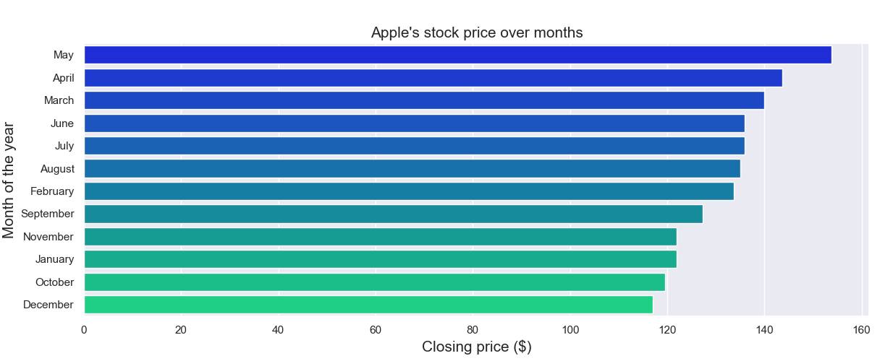
Monthly Stock Price

Slide 10
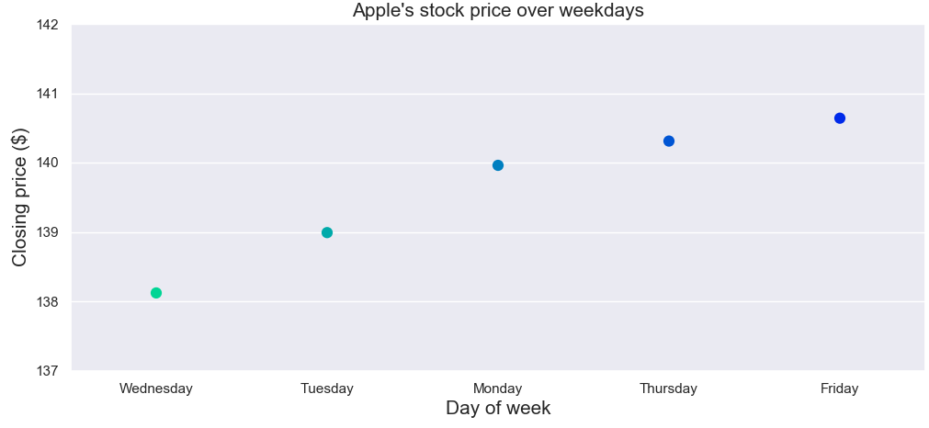
Day of Week Stock Price

Slide 11
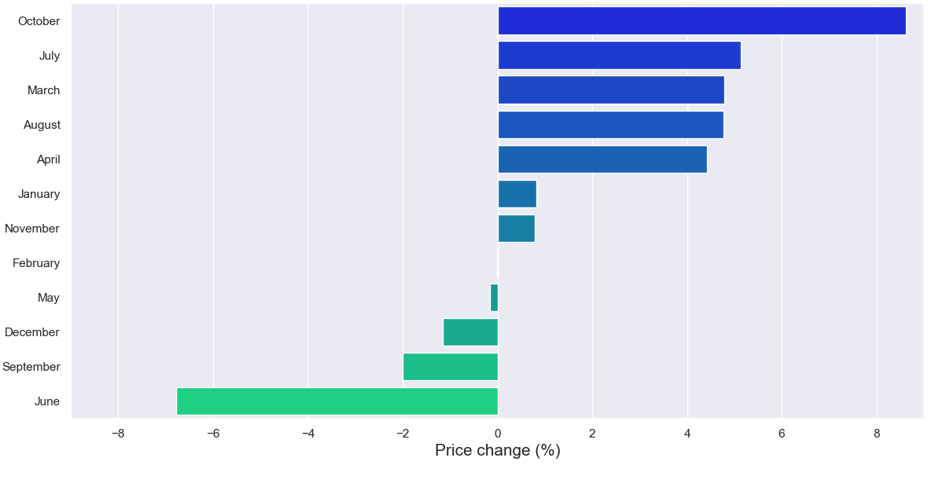
Monthly Stock Gain

Slide 12
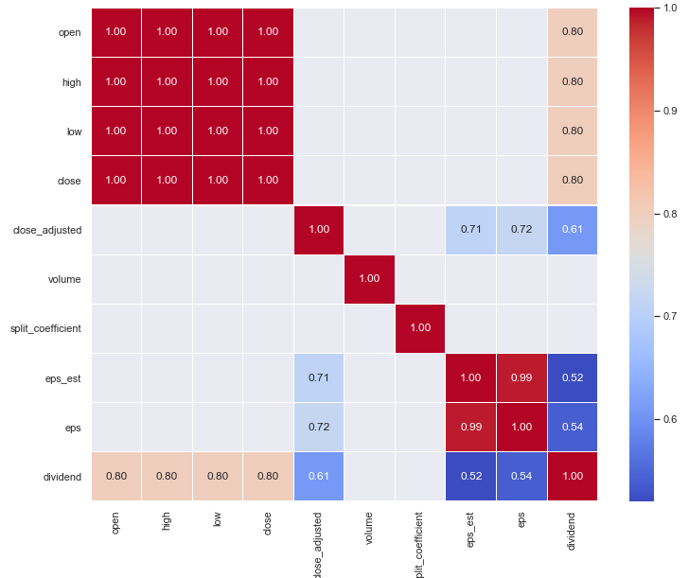
Highly Correlated Stock Variables
Variables |  | Correlations
Prices (close, open, high, low) | Dividend | 0.80
Close adjusted | Eps | 0.72
Eps | Dividend | 0.52
High chance when price goes up, dividend goes up too and vice versa

Slide 13
Section 4:
Machine Learning Modelling

Slide 14
Machine Learning
ARIMA
FBProphet
The scientific study of algorithms and statistical models to effectively predict future outcomes based on previously known patterns
XGBoost

Slide 15
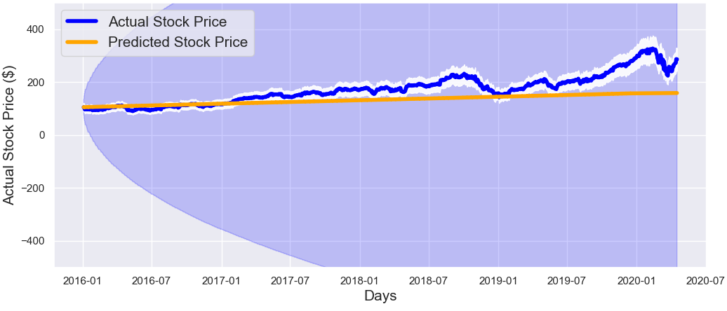
Auto Regressive Integrated Moving Average (ARIMA)
Predicted Y(t) = constant + p lags of Y(t) + q lags of error terms
Good Prediction
Best model parameters (p, d, q) = (0, 1, 0)

Slide 16
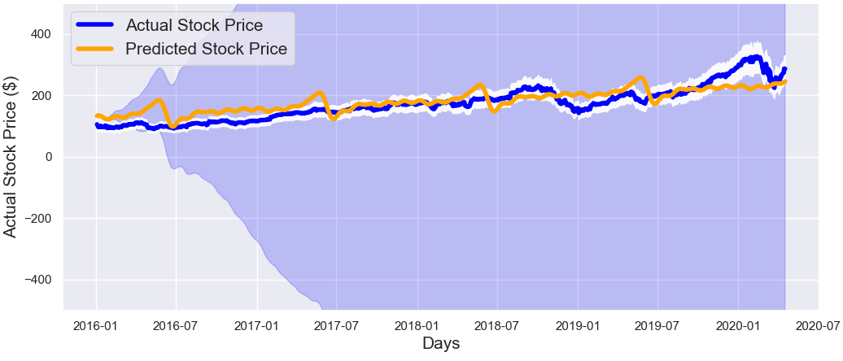
FBProphet
Predicted Y(t) = Trend, T(t) + Seasonality, S(t) + Holidays, H(t) + 𝜖 (error)
Good Prediction
Considering, trend change, seasonality and error modelling produced best predictions

Slide 17
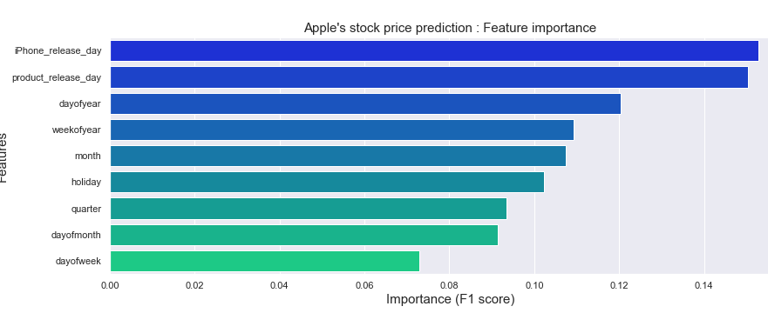
XGBoost
Frame time-series as regression model
Feature importance can draw most insight from XGBoost
Good Prediction
iPhone release dates and product release dates are most impactful on the stock price

Slide 18
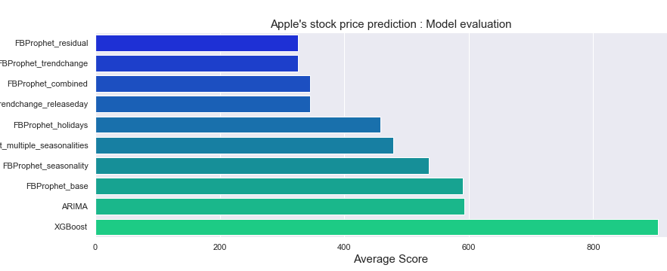
Machine Learning Results
Notes:
Linear Regression - MPM
t2_sat_area(microns2) = 2.514793e-04
int_s_avg_5(counts/ms) = 1.243470e-04
Random Forest - MPM
Tree = 3
t2_sat_num(-) = 0.64
int_s_p(counts/ms) = 0.33

Slide 19
Machine Learning Results
Model | MSE | MAE | RMSE | MAPE | Average_score
ARIMA | 2288.39 | 36.92 | 47.83 | 0.19 | 593.33
Best FBProphet Model | 1236.84 | 28.47 | 35.16 | 0.18 | 325.16
XGBoost | 3511.63 | 45.55 | 59.25 | 0.29 | 904.18
NOTE:
FBProphet improved RMSE by 26 % and 40% than ARIMA and XGBoost models
GitHub Link for time-series forecast modelling
Notes:
Linear Regression - MPM
t2_sat_area(microns2) = 2.514793e-04
int_s_avg_5(counts/ms) = 1.243470e-04
Random Forest - MPM
Tree = 3
t2_sat_num(-) = 0.64
int_s_p(counts/ms) = 0.33

Slide 20
Section 5:
Conclusion

Slide 21
Conclusion
EDA
Modelling
Results
January to June seen gradual increase of sctock price, sudden fall in July then again gradual increase till December
Best ARIMA model parameter (p, d, q) = (0, 1, 0)
FBProphet reduced RMSE by 26% and 40% compared to ARIMA and XGBoost model
Best FBProphet model considered trend changes, seasonalities (yearly, daily) and error modelling
Monday started with lowest price of the week then gradual increase till Friday with peak on Thursday
iPhone and product release dates are influencial features for price prediction derived from XGBoost
Highest stock gain seen in October and loss in June

Slide 22
Looking Forward
FBProphet Grid Search
Online App Deployment
Current
Limited by computational resources | Currently not done
Cloud computation can help find best parameters | This model can be integrated into production step
Future

Slide 23
Thank You
Md Saimoom Ferdous
Email: saimoom_026@yahoo.com
LinkedIn: https://www.linkedin.com/in/saimoom-ferdous/
GitHub: https://github.com/saimoom026
Project Details: https://github.com/saimoom026/Springboard/tree/student-branch/springboard/Capstone%20two

